Slide 1


Slide 2
Why new Healthy Eating Guidelines?
Healthy Ireland surveys 2015 and 2016 identified population eating problems
FSAI scientific recommendations for Healthy Eating Guidelines
Health Research Board review of the Food Pyramid – the tool Department uses for health professional and consumer healthy eating guide

Slide 3
What has changed?
Separating the Top Shelf
Moving Fruit and Vegetables to base of FP
Moving the Wholemeal Cereals and Breads, Potatoes, Pasta and Rice Shelf up
Increasing the serving size for that shelf and changing the range of servings
Addition of average daily calorie need

Slide 4
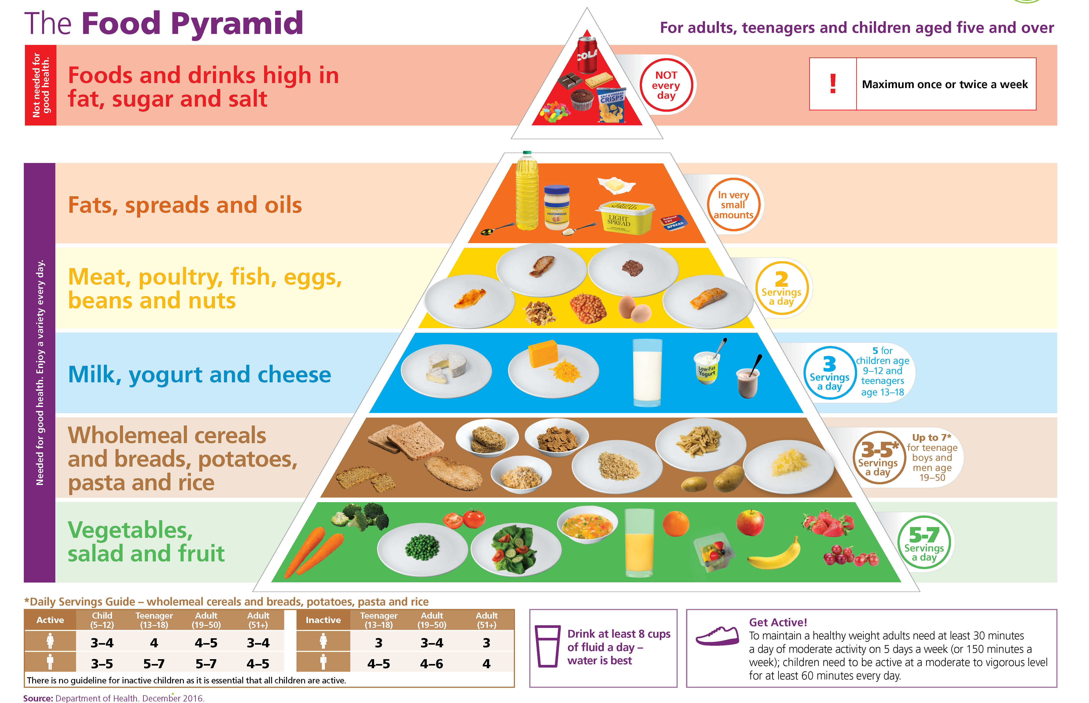

Slide 5
Separating the Top Shelf
Foods and drinks high in fat, sugar and salt are not needed for good health.
6 in 10 Irish people eat up to 6 of these every day and 4 in 10 eat more than 6
High in calories
Contain very few other nutrients
Over-consumption leads to overweight and obesity

Slide 6
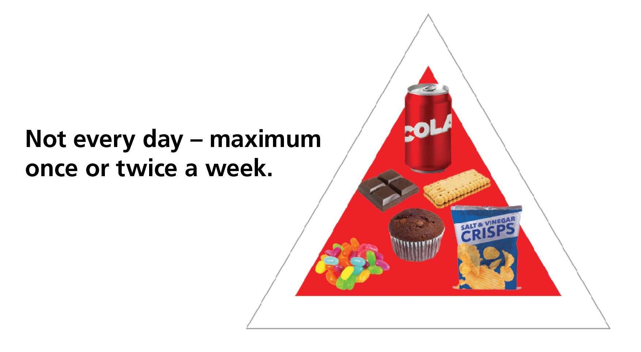

Slide 7
Slide of top shelf v healthy foods to forward to Ruth

Slide 8
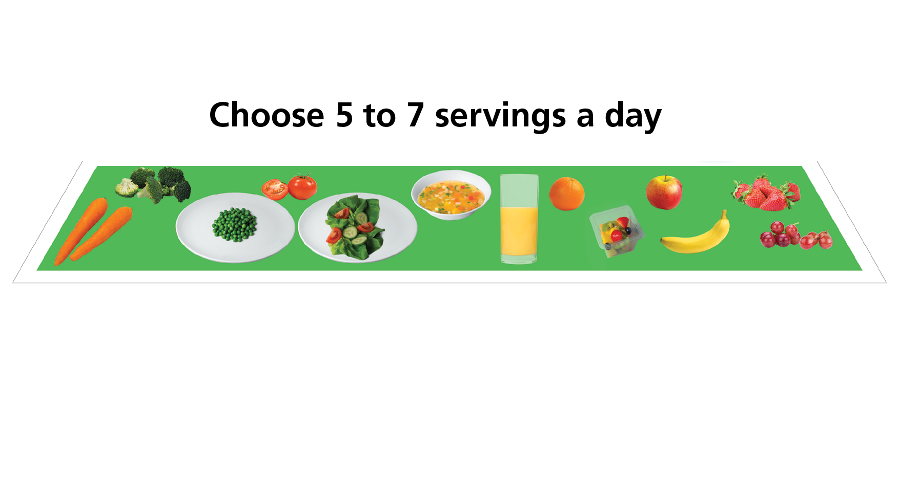

Slide 9
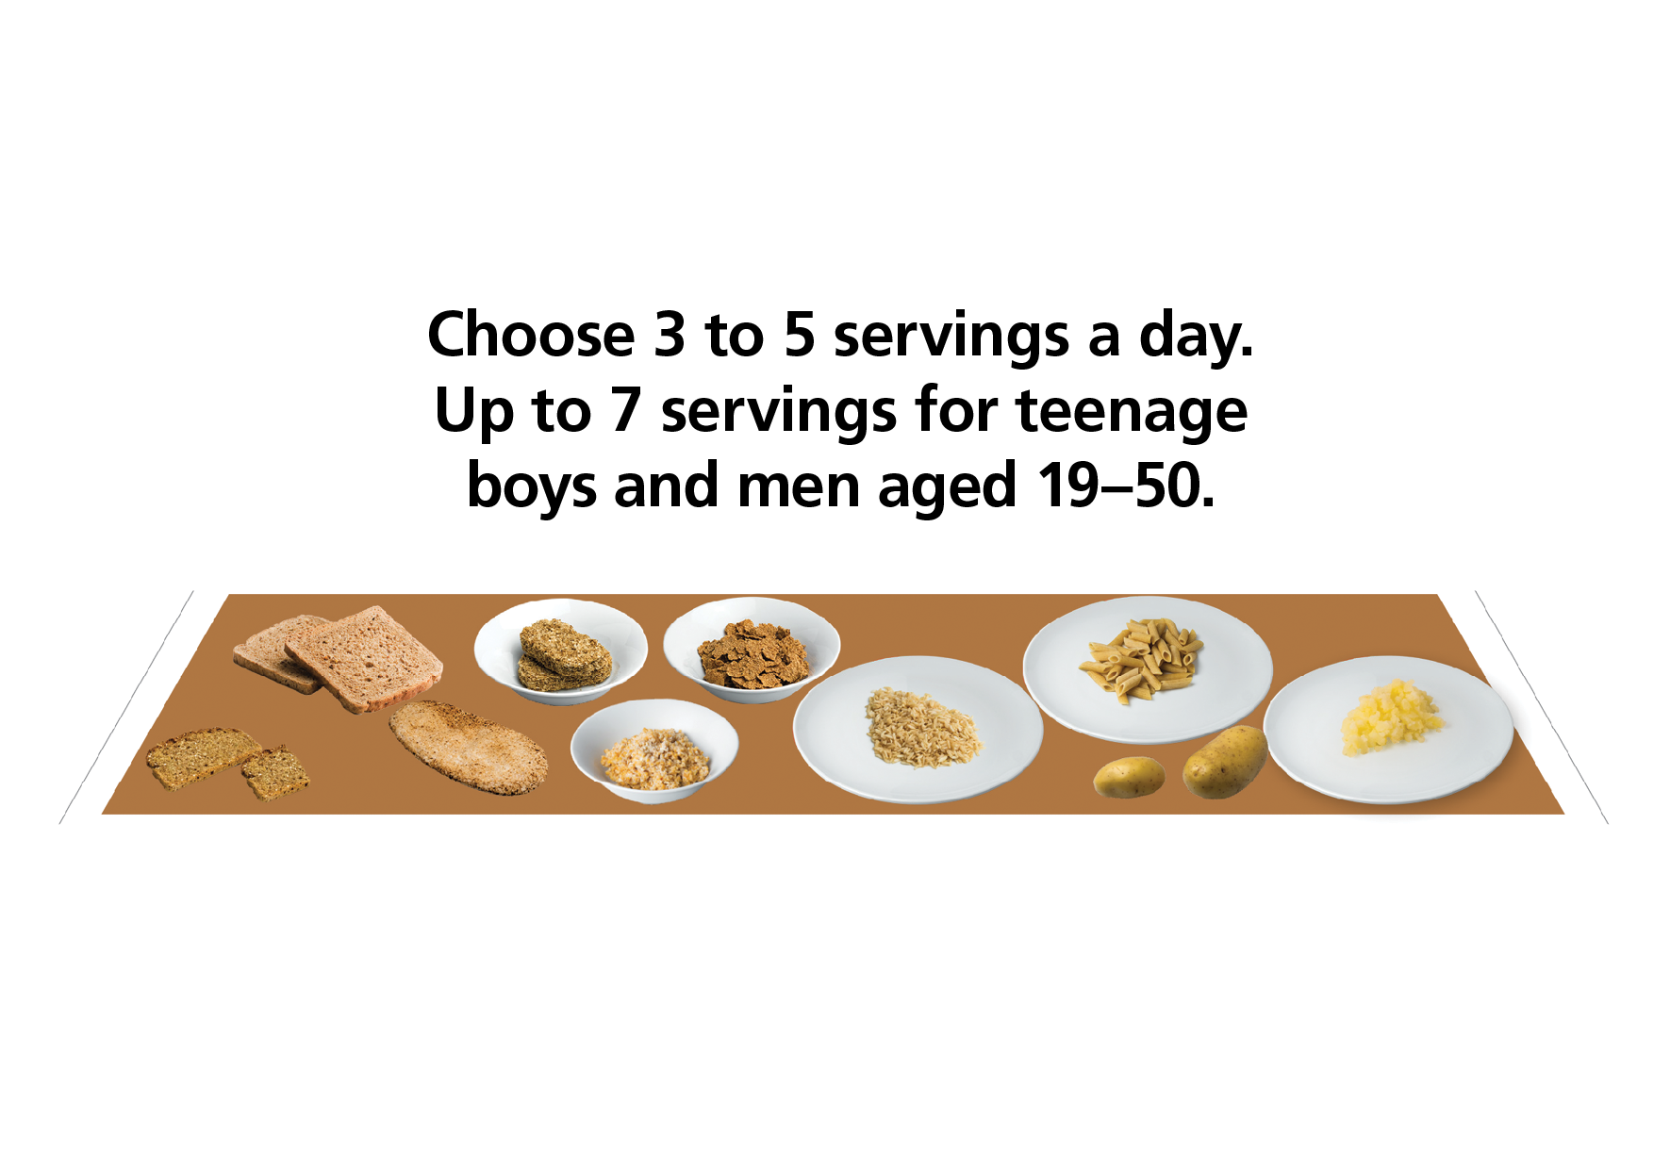

Slide 10
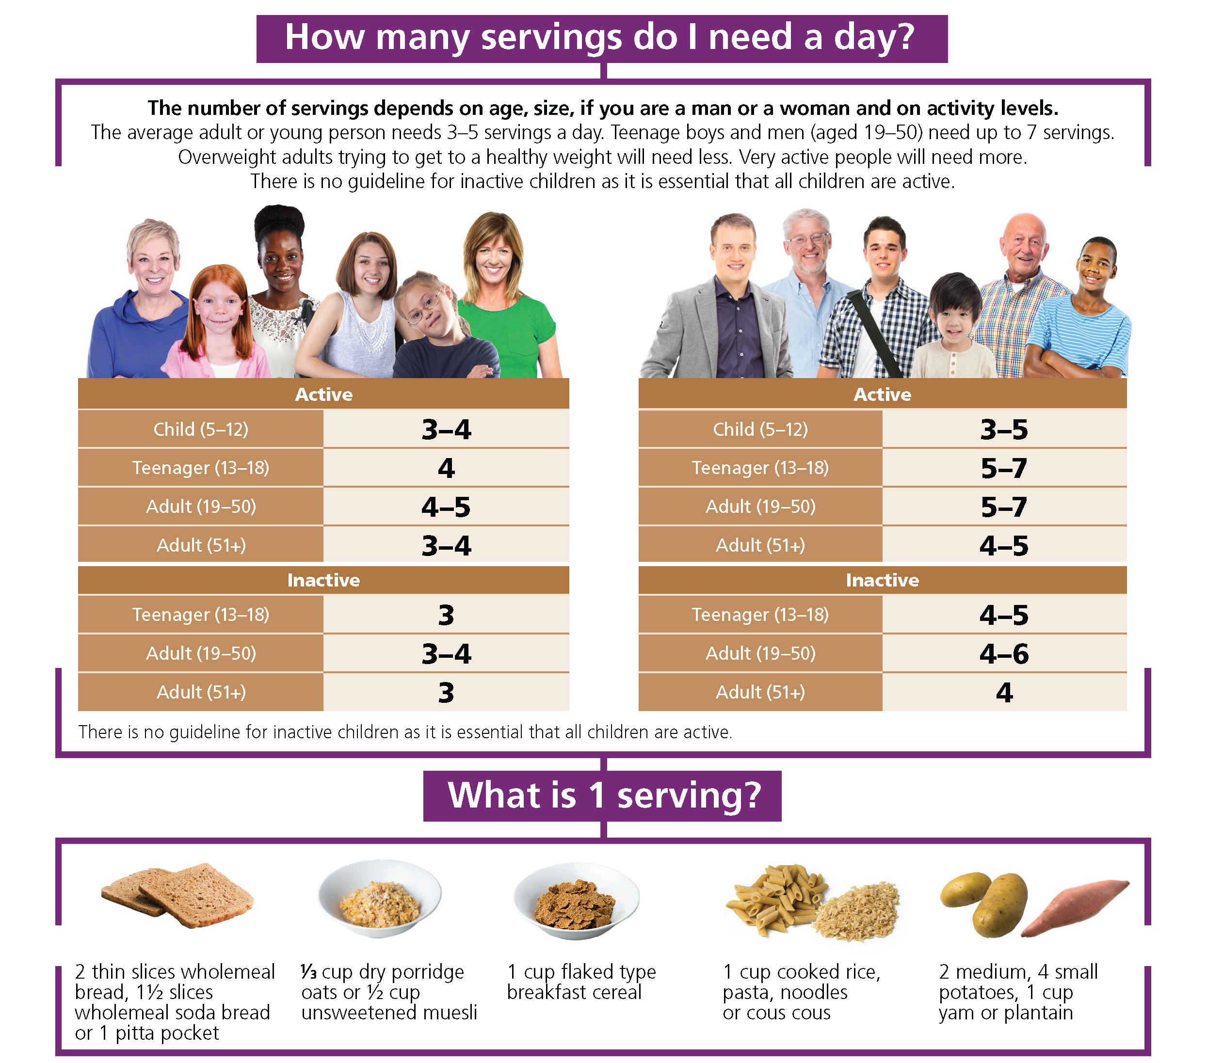

Slide 11
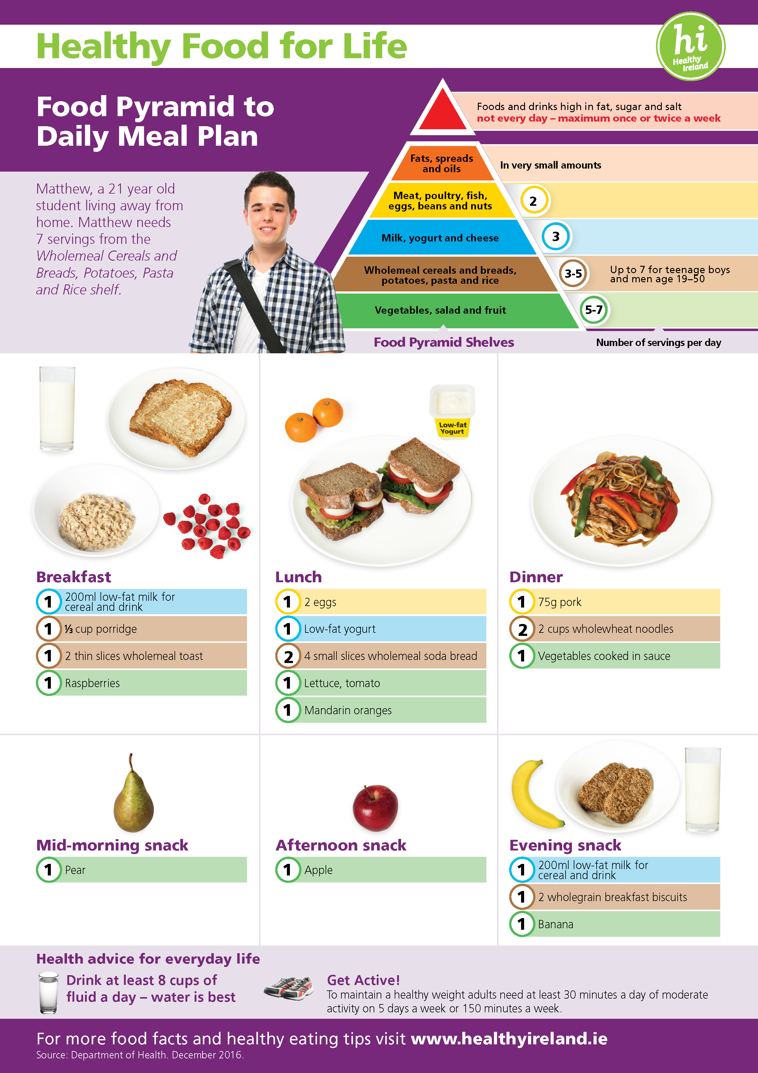

Slide 12
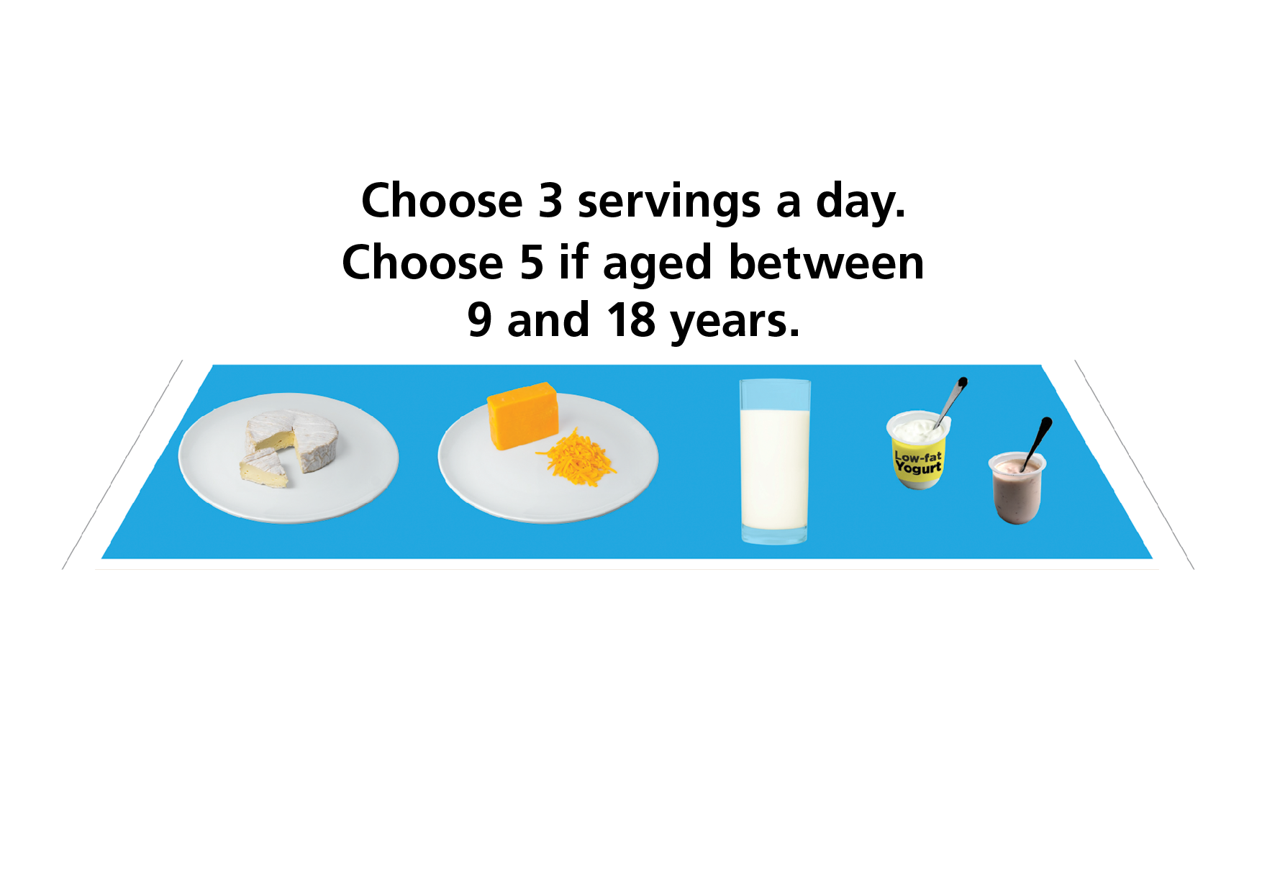

Slide 13
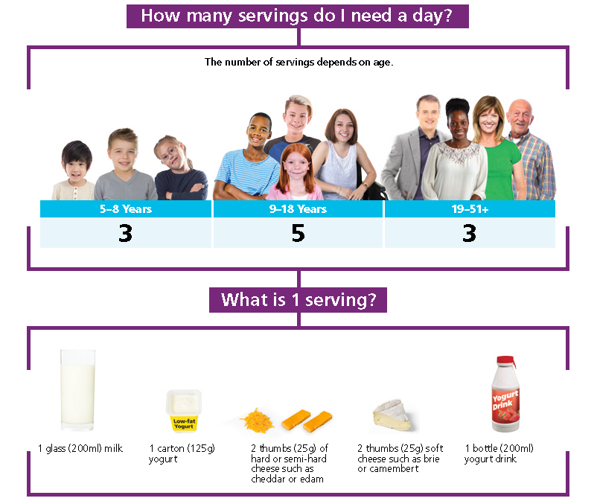

Slide 14
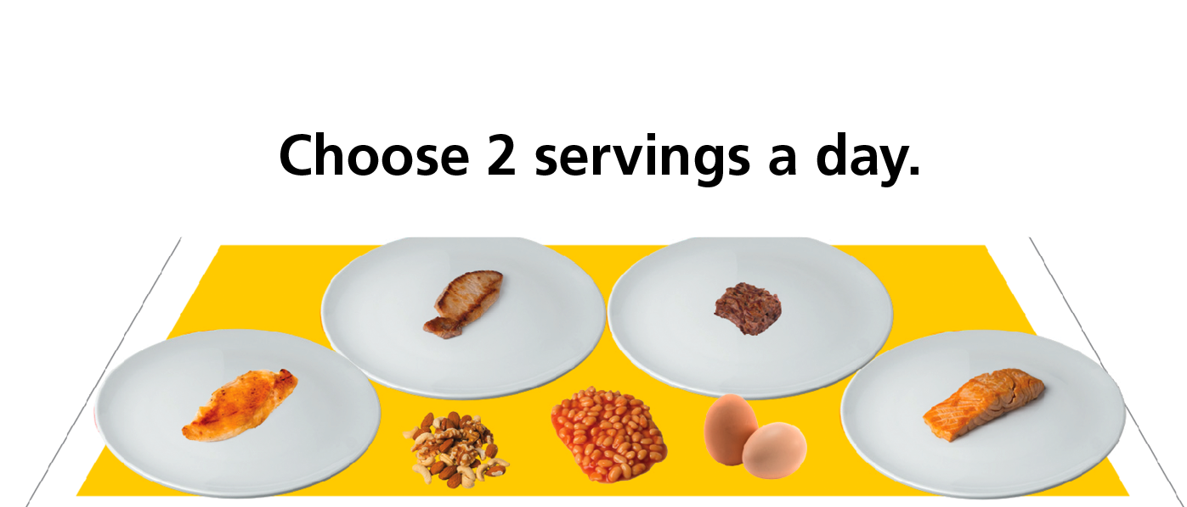

Slide 15
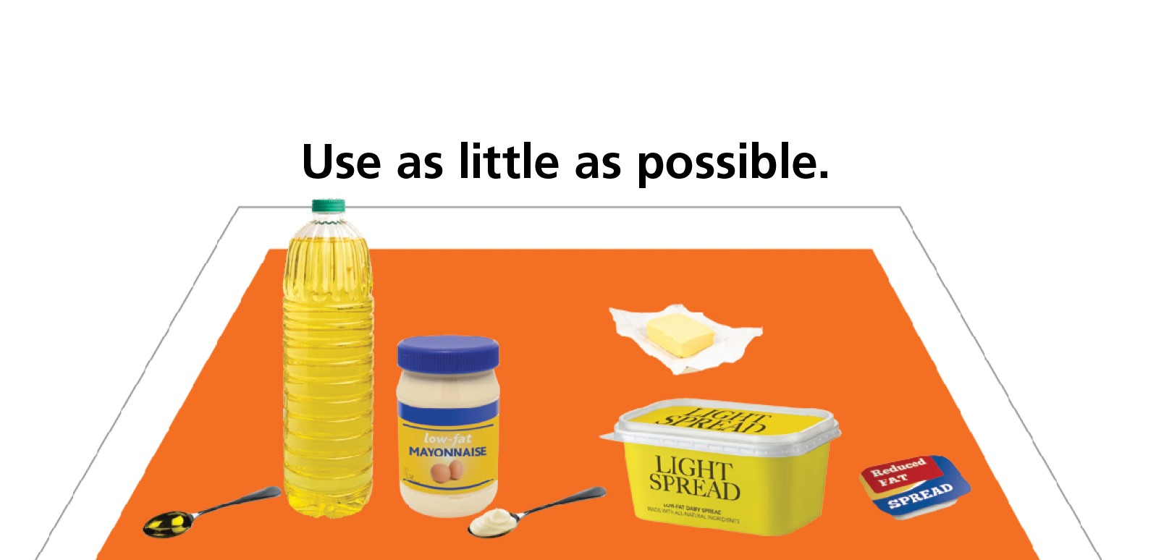

Slide 16
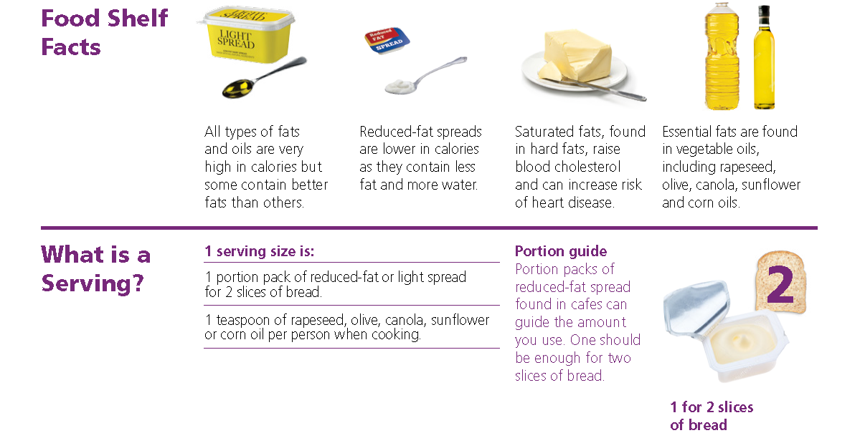

Slide 17
Is the Food Pyramid for everyone?
The Food Pyramid is for children over 5 and all adults, both healthy weight and overweight
2 out of 3 adults are overweight or obese
Top Tips for losing weight included in the leaflet
Guidance is given for active and inactive adults

Slide 18
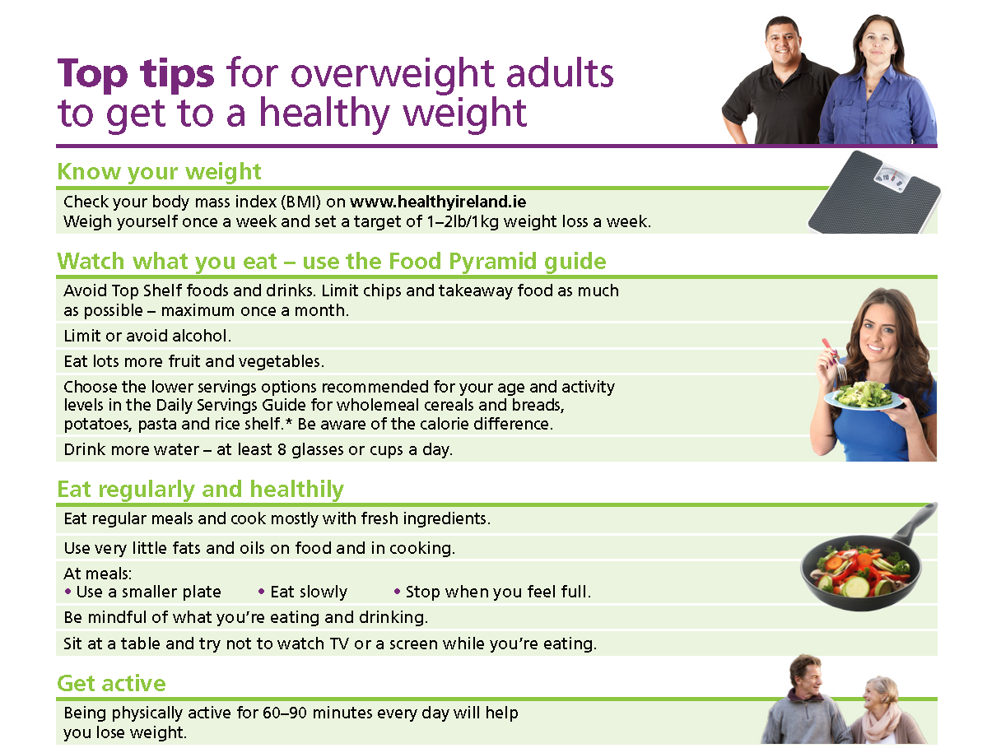

Slide 19
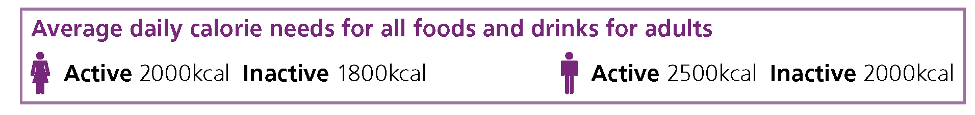

Slide 20
Three key consumer messages
Limit high-fat, sugar, salt foods (HFSS) and drinks from the Top Shelf
Eat more Vegetables, Salad and Fruit - up to 7 servings a day
Size matters - use the Food Pyramid as a guide for serving sizes

Slide 21
Resource Toolkit
From Food Pyramid to Plate- large range of resources
Very visual and colourful
Advice for all age groups from 5 years onwards
Guidance on activity levels
Implementation Plan 2017
Next step – 1-5 year old children and older adults

Slide 22
For further information
Visit the Healthy Ireland website
http://www.healthyireland.ie/health-initiatives/heg/

